Slide 1

2024-2025 Cohort Technical Assistance
Community of Practice
Holistic Practices in Employment & Day Services
January 16, 2025
10:00am-11:00am CT

Slide 2

Agenda
Quick reminder: what the data says
10 essential elements & CLE Guideposts
Siloed vs holistic approaches
Individual considerations
Organizational considerations
Foundational, 2nd & 3rd Generation, Sustainability practices
Let's hear from you!
Wrap-up, announcements

Slide 3
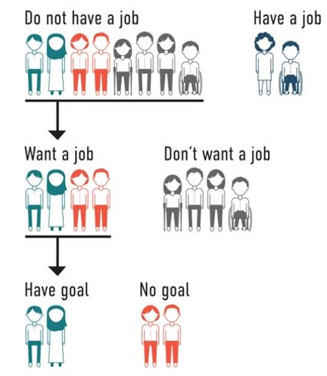
What does the Data say?
86% Don’t have a job
51% Want a job
37% Have a goal in their plan
https://www.nationalcoreindicators.org/2020-2021
Notes:
Staci
I have 2 pieces of data that I believe point to why having a more integrated approach is critical.
We know by looking at national data that most people that receive funded day or employment services are in the nonwork category.....ant to share the most recent national core indicator data from 2021 (and you can find this data at nationalcoreindicators.org), this data shows that out of individuals with disabilities surveyed, 86% reported not having a job. Out of that 86%, 51% of people reported WANTING a job. And perhaps the most critical piece of data here is that only 37% report having an employment goal in their current person centered service plans. So we can see from this data the discrepancy between what people report wanting in their lives vs what might end up in their service plan.

Slide 4
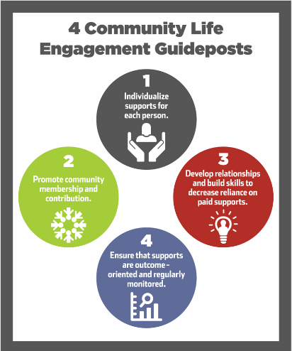
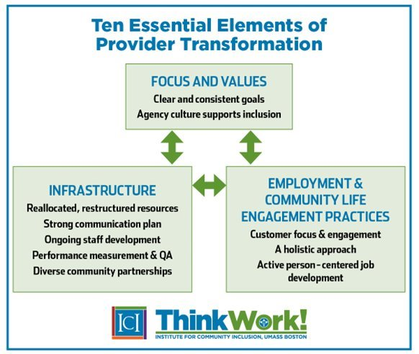

Slide 5

Notes:
Don

Slide 6

Legacy Models:
Siloing &
Potential Unintended Consequences
Different values, vision, culture & expectations
Lack of flexibility
Different expectations
Communication gaps and/or confusion
Limited resources
Duplication of efforts
Program-centered vs. Person-centered
Lack of movement toward employment
Only looking at one part of a person or service
Notes:
Staci

Slide 7
Characteristics of Updated Service Models
Individualized & flexible
Integrated & community-based
Blended services vs programs
Employment First philosophy and practices
Prioritize competitive, integrated employment (CIE)
Community life engagement
Outcome oriented
Active, individualized job development process
Wrap-around non-work supports
Holistic!
Notes:
Staci

Slide 8
Holistic Service Delivery
Designed around the person and with the person & their family
Teams & support networks collaborate & communicate (paid and unpaid)
Flexible, blended & customized (only levels of service people need/want)
Schedules are integrated and make sense for the person
Continuous skill & relationship building
Continual learning, documentation and adjustment
Work informs non-work & non-work informs work
Make employment everyone's business
Notes:
Staci
We will do a deeper dive on a few of these later in this presentation

Slide 9
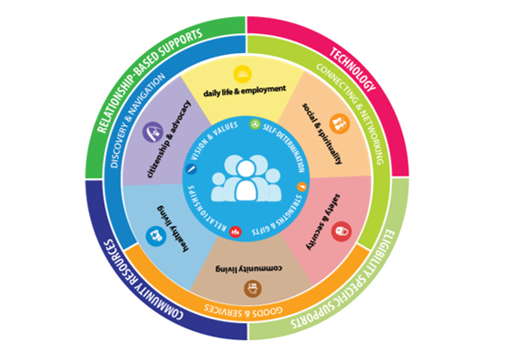
Services & Supports
Designed Holistically Around and
With the Person
& Their Family
www.LifeCourseTools.com
Notes:
Staci

Slide 10

Bake
Person-Centered
Thinking
& Planning into
Service Delivery
& Culture
Note: this isn't just filling out a form
Notes:
Staci
This isn't a form you are filling out, this is a fundamental shift in how we see people, how we talk about people and how we support people.

Slide 11
 | Point of Engagement
 | Person-Centered Thinking, Discovery, Assessment and Planning
 | Individual Service Plan
Practices → CIE Outcomes |  | Practices → CLE Outcomes
CIE Exploration |  | CLE Exploration
CIE Themes and Goals |  | CLE Themes and Goals
CIE Plan |  | CLE Plan
Employment Development: Conventional/Customized |  | Community Development: Conventional/Customized
Accommodations and Assistive Technologies |  | Accommodations and Assistive Technologies
Transportation Planning |  | Transportation Planning
Disability Benefits and Healthcare Planning |  | Wellness and Physical Fitness Planning
Job Skills Training and Job Coaching |  | Life Skills Training and Activities Coaching
Natural CIE Supports |  | Natural CLE Supports
Work Schedule |  | Non-Work Schedule
CIE Follow-Up |  | Community Inclusion Follow-Up
Supported Employment |  | Ongoing CLE Supports
Job Growth and Progression |  | Individual Growth and Expression
Referral and Coordination with CLE |  | Referral and Coordination with CIE
Person-Centered Practices that Support an Inclusive Working Life
Source: The Death of Rehabilitation, or Lighting New Pathways to an Inclusive Working Life, Cambridge Scholars Publishing,

Slide 12
Guidance for Conversations
Instead of "Do you want to work?"
Ask things like:
  Imagine yourself working, what would you be doing?
  Tell me what you like most about your day?
  What would you do if you had more money?
  What are you good at?
  What are things you don't like to do?
https://static.prod01.ue1.p.pcomm.net/umass/content/SELN-guidance-jan-2019.pdf
Notes:
Staci

Slide 13

Organizational Considerations
Taking a Step Back
Notes:
Brian
Let’s discuss organizational considerations for delivering Day Support Services in the community and supporting competitive integrated employment

Slide 14


CLE: momentum toward employment
Remember 'non-work mountain'
Employment oriented for working age
Raise expectations
CLE Guideposts:
  Individualized
  Promote community membership
  Increase skills and relationships
  Focus on individual goals
www.CLEtoolkit.communityinclusion.org

Slide 15
Using Employment to Inform Non-work
(over & over again)
Active, person-centered job development process
How are you using Discovery (or discovery) profiles to build individual community services?
  Skills, abilities, interests, themes
  Communication
  Technology
  Natural supports
  Help the person maintain and build relationships & networks
  Ideal conditions for community life
Wrap-around non-work for additional skill building
Notes:
Brian

Slide 16
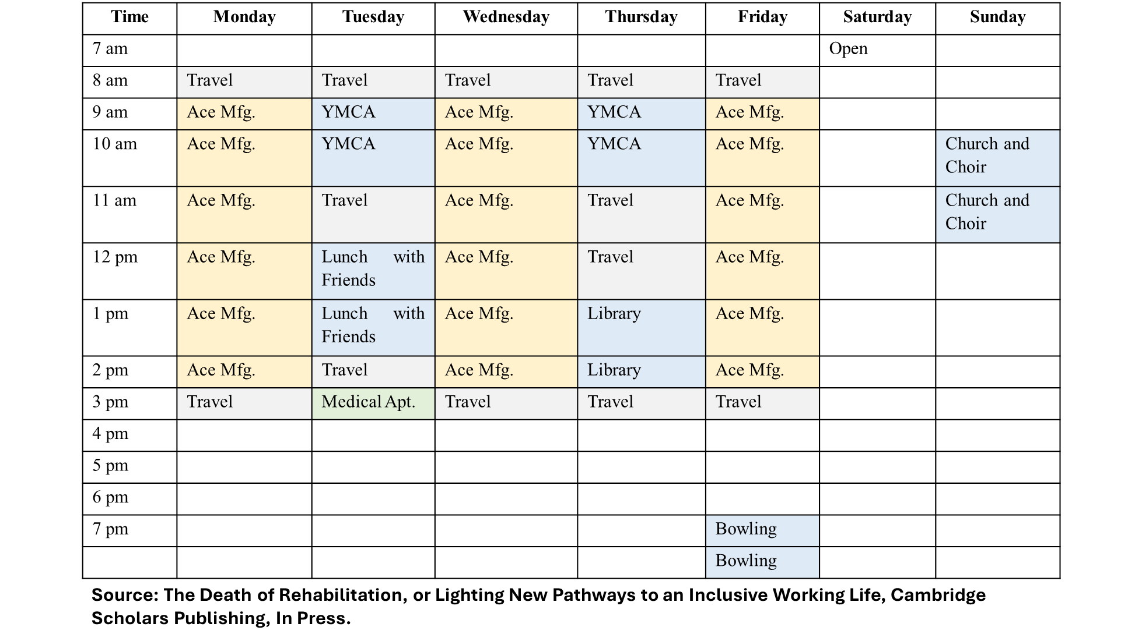
Notes:
In summary, there are 31 hours of planned weekly activities. There are 18 hours spent in the workplace, with 16.5 paid work hours in CIE (and 1.5 hours for lunch breaks). Of this total, only six hours of direct staff time were determined to be needed. Also, there are 12 hours of CLE scheduled each week (four hours at the YMCA, two hours for lunch with friends, two hours for library visits, two hours for league bowling, and two hours for church service and choir). Of this total, only five hours of CLE direct support time is planned. Finally, there is a one-hour medical appointment where paid residential support is scheduled to help.
Fifty-five percent of the total hours of support this individual receives in CIE and CLE is provided through natural means. This is a total of 17 hours, including ten hours a week in CIE and seven hours a week in CLE activities. The residential provider will provide one hour of paid staff support.
So, in this particular service construct, 31 hours are being spent by this individual in inclusive work and non-work community settings. Seventeen of these hours are supported naturally, one hour through a paid caregiver by the residential provider, and 11 hours of direct staff support will be delivered by the organization to support CIE and CLE outcomes on the schedule

Slide 17




Foundational practices:
Person centered thinking & planning principles, staff training
Sharing information across departments
Second & third-generation practices:
Use of universal practices (customized employment, discovery, community mapping, etc.)
Sustainability practices:
People have individualized and person-centered outcomes

Slide 18
Let’s hear from you!
What are you doing to break down 'siloes' between work and non-work service delivery?

Slide 19
Wrap-up & Announcements
Next CoP: February 20, 2025
Quarterly Training: February 13, 1-2:30 pm
  Topic: assistive technology

